Slide 1
201812
Tungsten Tip Etching
Lee Jong Geon

Slide 2
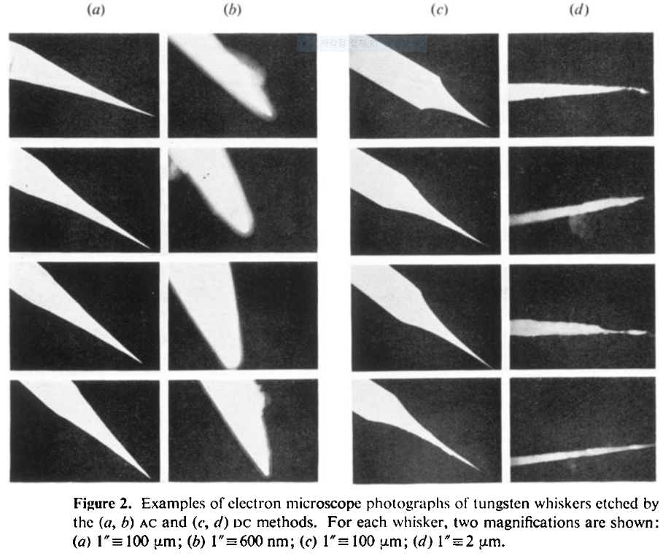
1978-J. Phys. D: Appl. Phys.-11-A comparison of AC and DC electrochemical etching techniques for the fabrication of tungsten whiskers (G. J. Edwards and P. R. Pearce)
AC
DC

Slide 3
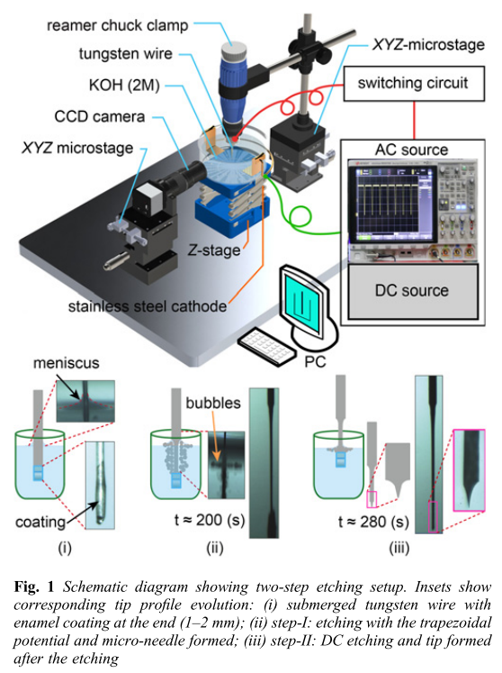
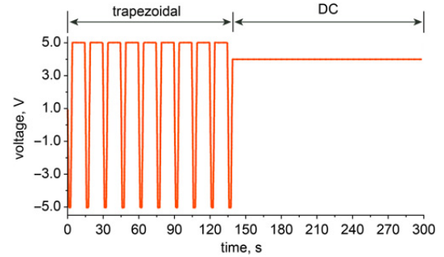
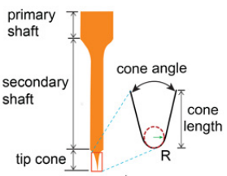
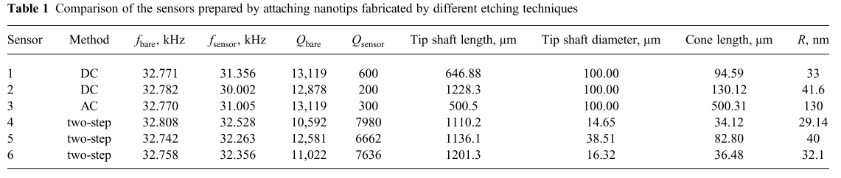
2018-Micro&Nano Letters-13,8-Electrochemical etching of lightweight nanotips for high quality-factor quartz tuning fork force sensor: atomic force microscopy applications (Danish Hussain, Jianmin Song, Hao Zhang, Xianghe meng and Hui Xie)
Two step
Primary shaft diameter: 10–40 μm
Length: 2–5 mm
Fabricated with high success rate (∼80%).
High Q-factor

Slide 4
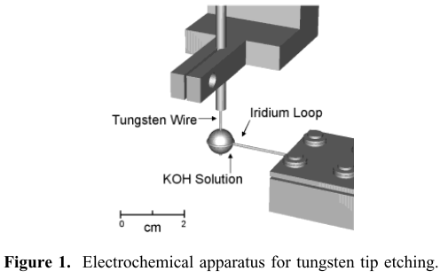
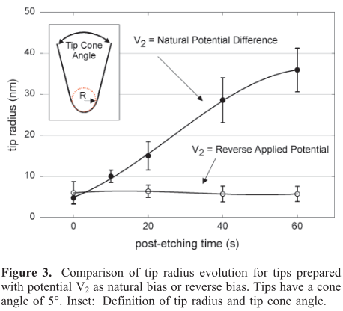
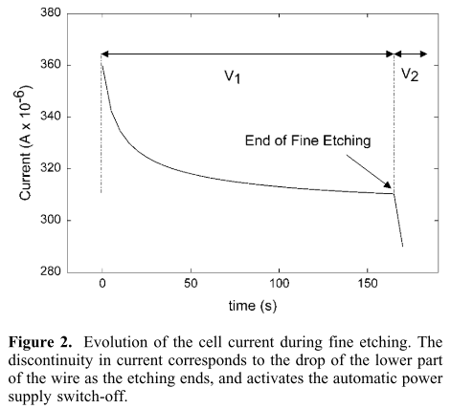
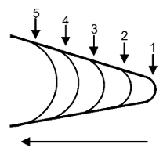
2002-Nano Letters-2,3-Reproducible Electrochemical Etching of Tungsten Probe Tips (Olivier L. Guise, Joachim W. Ahner, Moon-Chul Jung, Peter C. Goughnour, and John T. Yates, Jr.)
Post-etching: wire가 끊어진 이후에도 etching process를 진행하는 것
An average of at least 5 tips.
“This method produces tips in a very controlled and reproducible manner.”

Slide 5
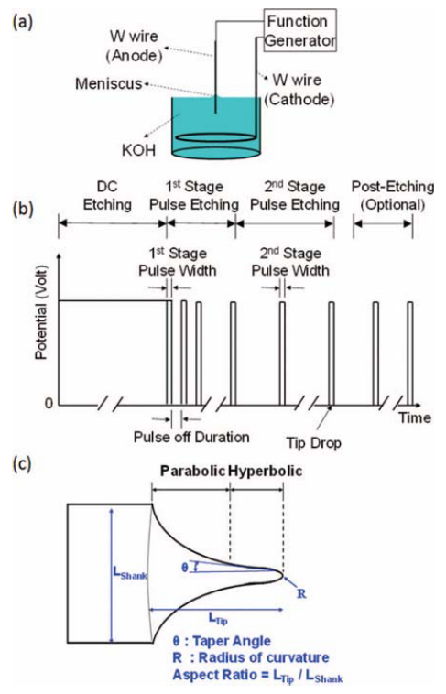
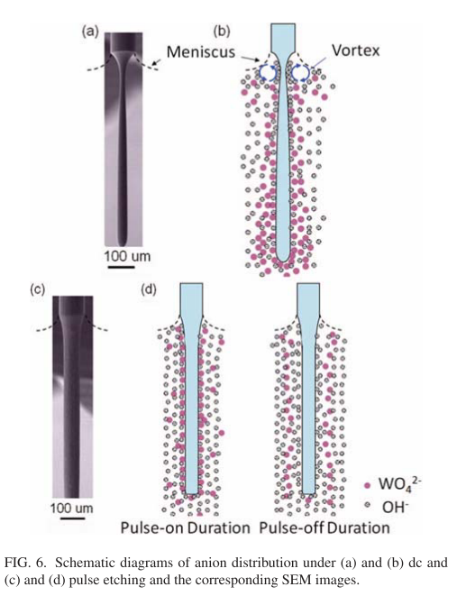
2012-Rev. Sci. Instrum.-83,08374-Method of electrochemical etching of tungsten tips with controllable profiles(Wei-Tse Chang, Ing-Shouh Hwang, Mu-Tung Chang, Chung-Yueh Lin, Wei-Hao Hsu and Jin-Long Hou)
10M
DC(uniform)
etching
“we propose a simple and reliable electrochemical method to fabricate tungsten tips with good control of the tip profile.”
Pulse
etching

Slide 6
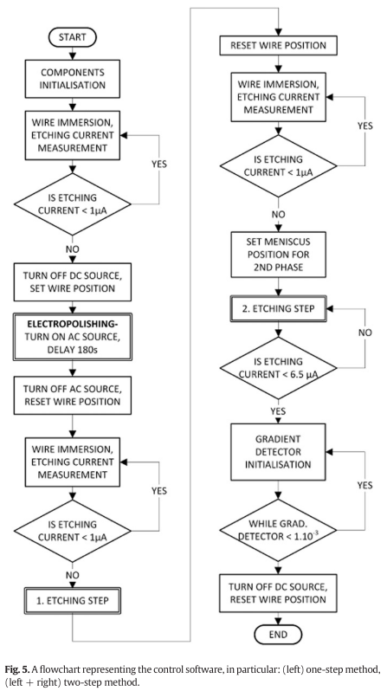
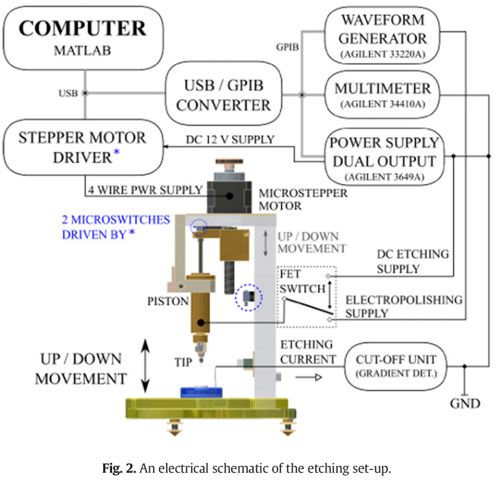
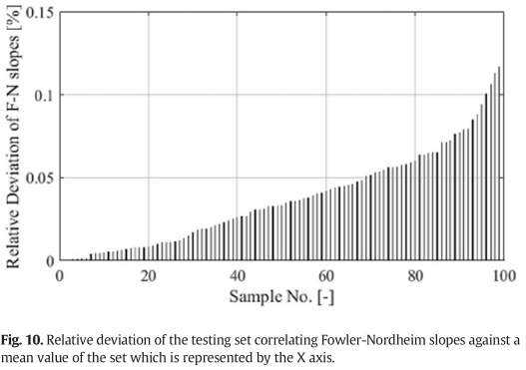
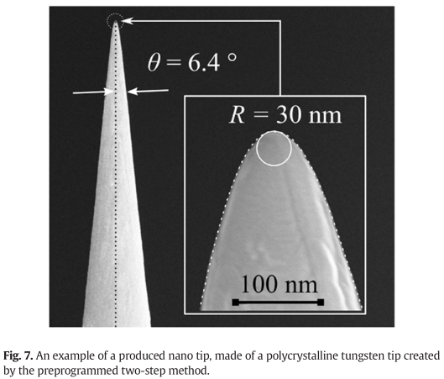
2017-Microelectronic Engineering-173-Progrmmable set-up for electrochemical preparation of STM tips and ultra-sharp field emission cathods(Alexandr Knapek, jiri Sykora, Jana Chlumska, Dinara Sobola)
“The programming allows for increasing the reproducibility of the preparation and improves the quality of the preparation process.”

Slide 7
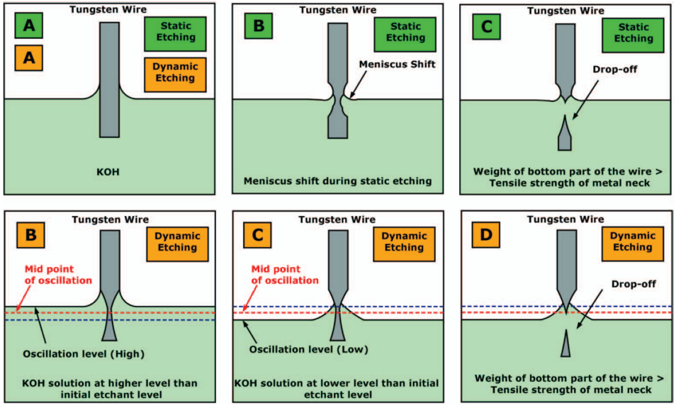
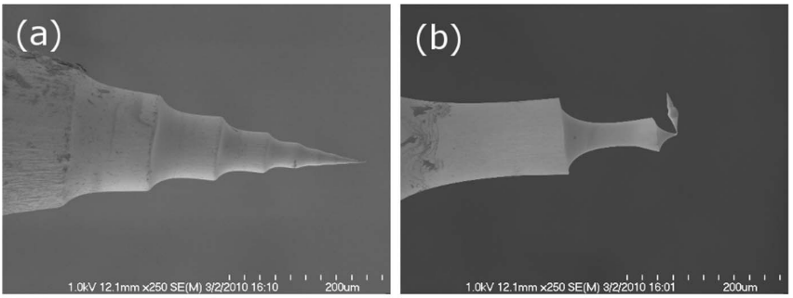
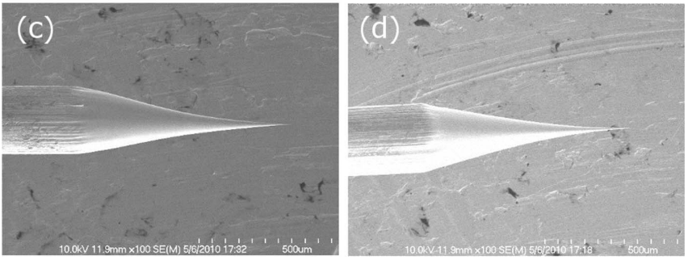
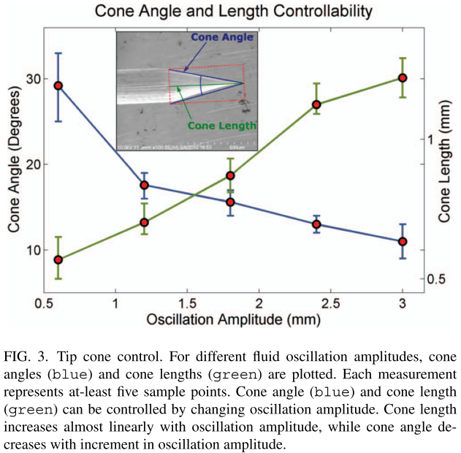
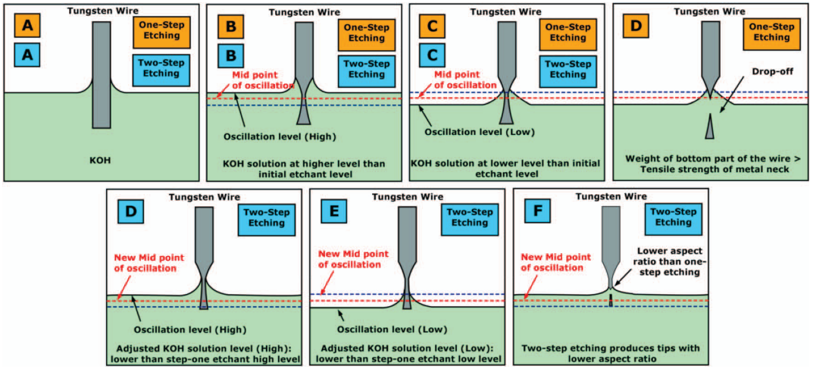
2012-Rev. Sci. Instrum.-83,6-Two step controllable electrochemical etching of tungsten scanning probe microscopy tips(Yasser Khan, Hisham Al-Falih, Yaping Zhang, Tien Khee Ng, Boon S. Ooi)
“The electrolyte solution level remains stagnant throughout the process, the meniscus often moves to a lower level”
Dynamic etching: the electrolyte level is vertically raised and lowered

